Slide 1
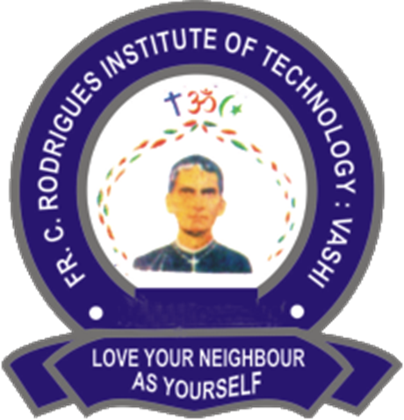


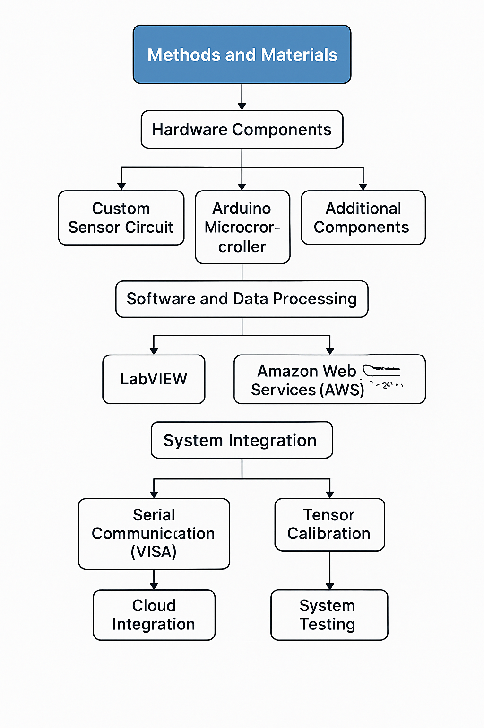

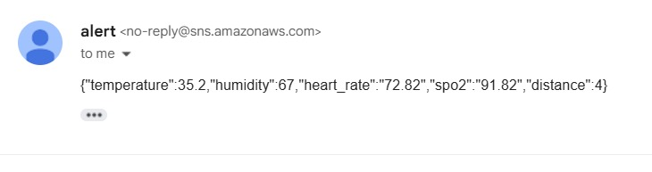
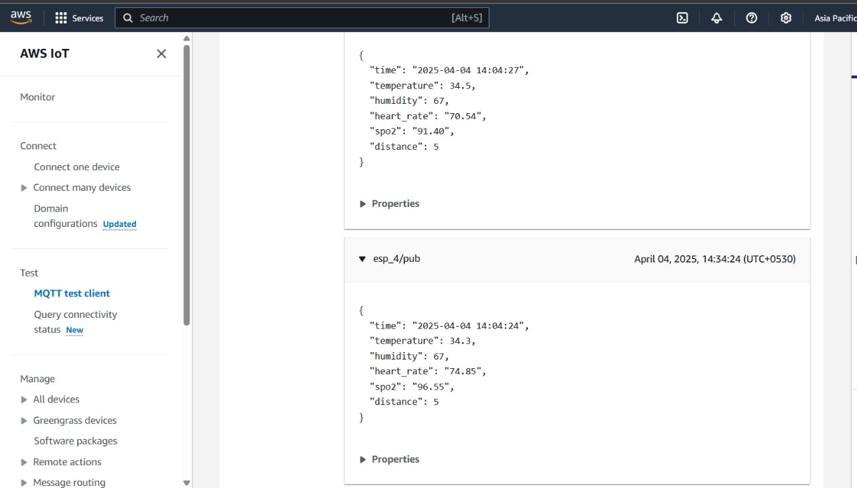
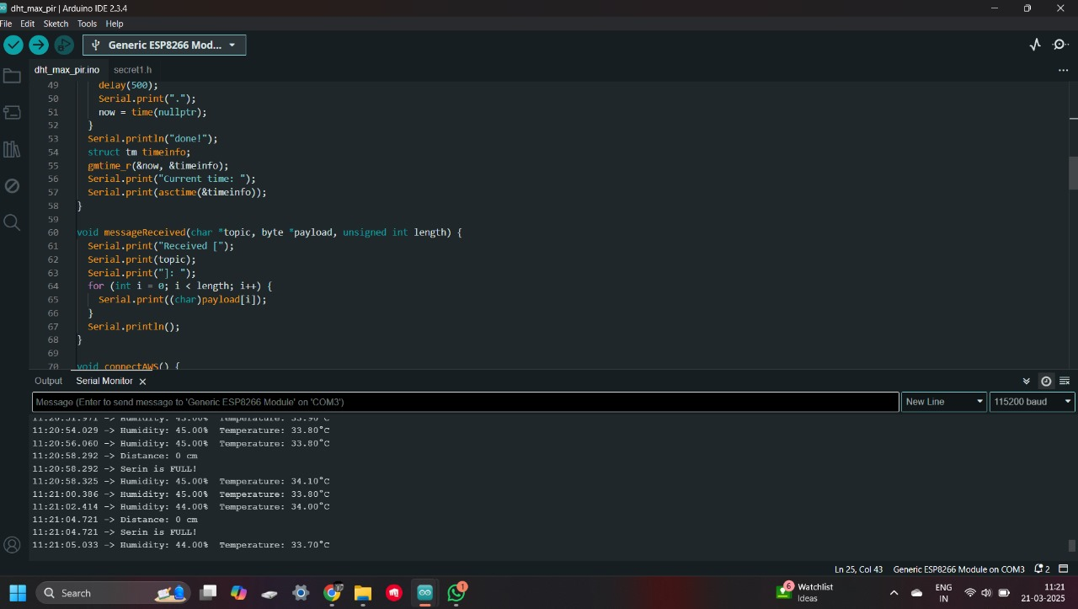
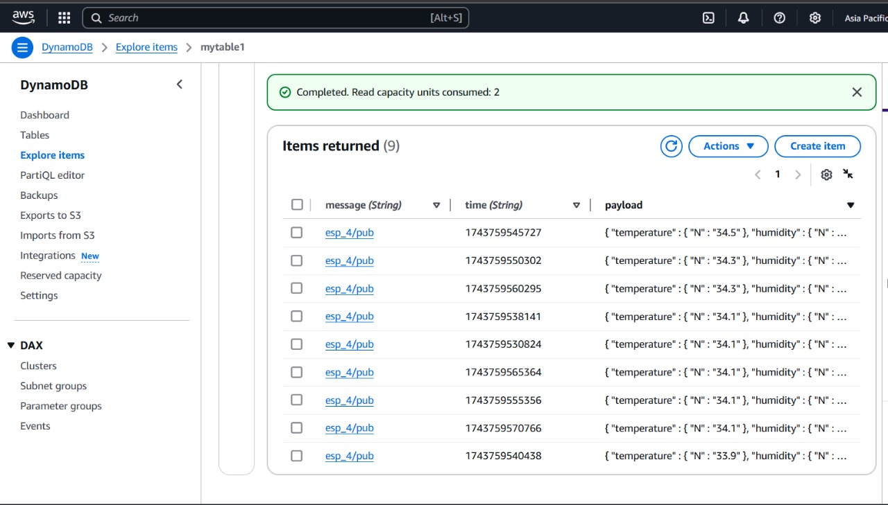
Agnel Charities’ Fr. C. Rodrigues Institute of Technology, Vashi, Navi Mumbai, India
(An Autonomous Institute & Permanently Affiliated to University of Mumbai)
IoT-Based Health Monitoring System
Author name :Diksha Bhosale | Varun Somwanshi
Pratik Belamkar | Mudabbir Ahmad
Abstract
Methods and Materials
This project presents the development of an IoT-based patient health monitoring system designed to measure, process, and transmit critical health metrics both locally and remotely. Locally, LabVIEW software is used to visualize waveform data and convert it into real-time numerical readings via serial communication. To enable remote monitoring and cloud-based analysis, the system integrates with AWS services. The ESP8266 microcontroller transmits processed sensor data wirelessly to AWS IoT Core using MQTT protocol. The data is then stored in Amazon DynamoDB and visualized using Amazon Timestream and Grafana dashboards.
Introduction
This project aims to develop an IoT-based health monitoring system that tracks various vital signs The system is designed to collect data from a custom-built sensor circuit, which is interfaced with an Arduino microcontroller. The Arduino processes the sensor data and communicates it to LabVIEW via serial communication, where it is displayed in graphical and numerical formats for easy interpretation. the system incorporates Amazon Web Services (AWS) for cloud-based storage and data analytics. This integration allows healthcare professionals to remotely monitor patient data and make data-driven decisions in real time.The combination of IoT, real-time data processing, and cloud integration represents a significant step toward creating a more efficient, reliable, and scalable healthcare solution. This project not only aims to improve the accuracy and timeliness of health monitoring but also contributes to the broader goal of transforming healthcare systems through digital innovation.
Results
Fig.1
Fig. 3
Fig. 2
Fig. 4
Discussion
Conclusions
This project successfully developed an IoT-based system using Arduino and LM358 to collect and process sensor data, which is transmitted to AWS for real-time monitoring and analysis. The architecture is scalable, cost-effective, and integrates services like AWS IoT Core, Lambda, and DynamoDB. While effective, the system faced minor challenges with network reliability and power optimization. Overall, it demonstrates a practical solution for applications in monitoring and automation.
The IoT-based sensor monitoring system developed in this project proves to be an efficient and scalable solution for real-time data acquisition and cloud-based analysis. By integrating Arduino with AWS services, the system enables seamless data flow from sensor to cloud, supporting intelligent monitoring and alert mechanisms. The successful implementation highlights the potential of combining low-cost hardware with powerful cloud platforms for applications in various domains such as environmental sensing, industrial automation, and healthcare. Future work can focus on enhancing power efficiency, improving network stability, and expanding the system’s capabilities with additional sensors and analytics features.
Refernce:
[1] V.Ramya, B.Palaniappan, A Kumari, "Embedded Patient Monitoring System", International Journal of Embedded Systems and Applications, Vol.1, Issue 2, pp.51-63, 2011.
[2] M J Jayashree, A Sam Sunny, Anu John, "Smart Hospital Technology", An International Journal on Health Informatics, Vol.3, Issue 3, pp.9-16, 2014.
[3] Bharat Prajapati Jignesh Patel, "An Intelligent Real Time IoT Based System (IRTBS) for Monitoring ICU Patient ", " In International Conference on Information and Communication Technology for Intelligent Systems, pp. 390-396. Springer, Cham, 2017.
Ccontact –Diksha Bhosale
Pratik Belamkar

